Slide 1


RxJava and SWT: Out with Events, in with FRP
@diffplug
Ned Twigg
Twitter @nedtwigg
All code examples available here
https://github.com/diffplug/rxjava_and_swt

Slide 2
What is Functional Reactive Programming
A buzzword for event-driven programming
Except the events live inside a pipe that models time explicitly
Epigrams in Programming #9 (Alan Perlis 1988, 30-50 years of experience)
It is better to have 100 functions operate on one data structure than 10 functions on 10 data structures.
SWT – ~30 event / listener pairs, 0 methods
RxJava – 1 event / listener pair, gazillion methods

Slide 3
What makes RxJava more “composable”?
In SWT, we add an event handler like this:
In RxJava, we add an event handler like this:
Observable is a pipe we can filter, map, and more!
widget.addListener(SWT.KeyDown, e -> {
// this is our chance to react
System.out.println("keyCode=" + e.keyCode);
});
Observable<Event> keyDownStream = SwtRx.addListener(widget, SWT.KeyDown);
keyDownStream.subscribe(e -> {
// this is our chance to react
System.out.println("keyCode=" + e.keyCode);
});

Slide 4
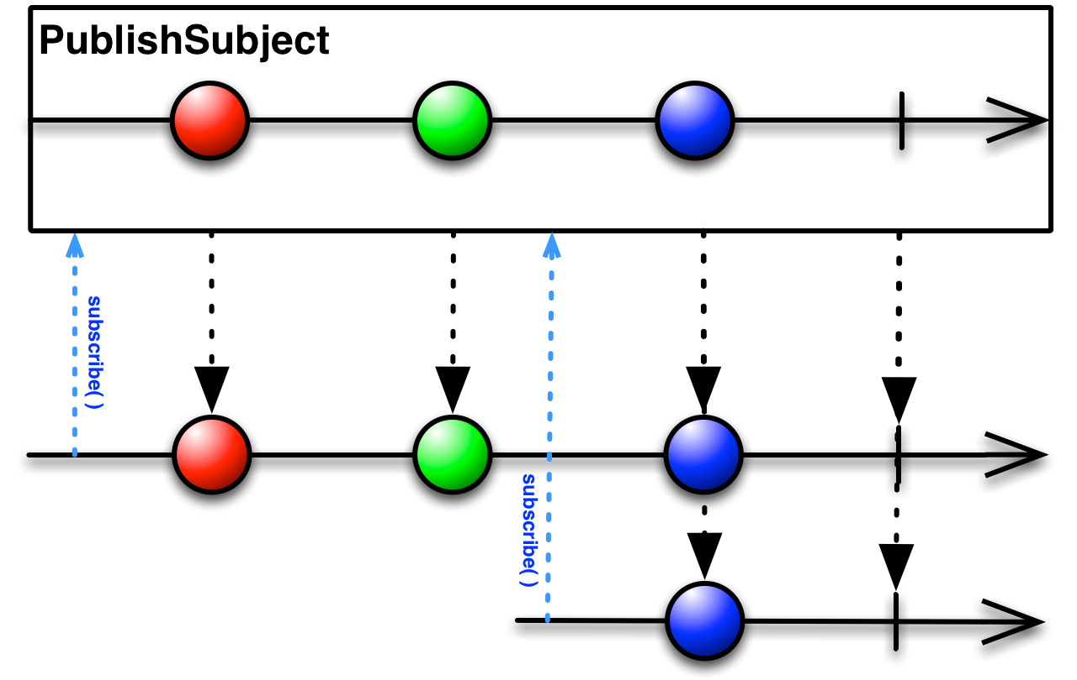
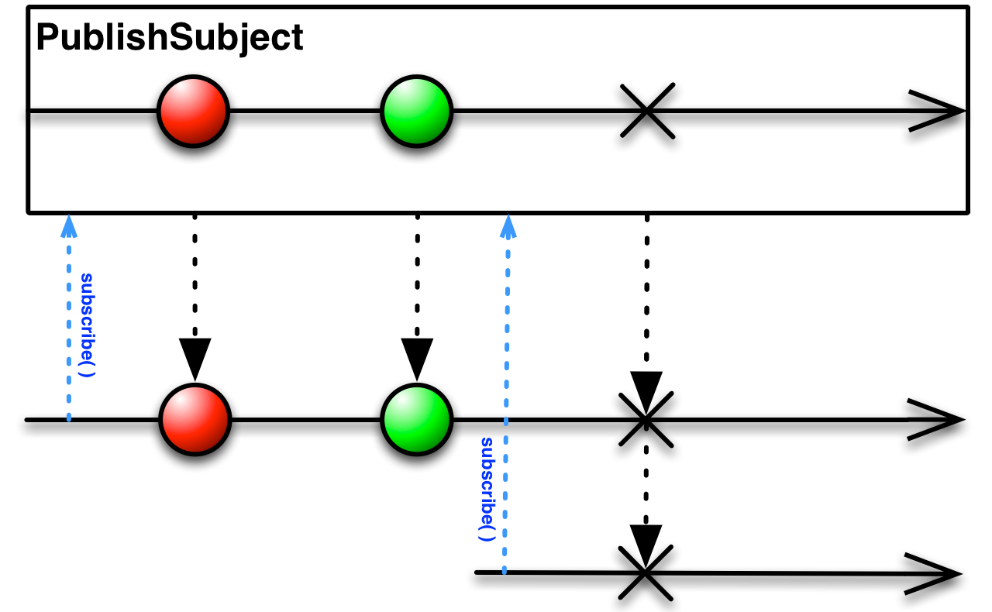
What is an “Observable”
You can subscribe an Observer<T> with these methods:
public interface Observer<T> {
void onNext(T t);
void onComplete();
void onError(Throwable e);
}

Slide 5
What good is a pipe?
Event callbacks and event streams are the same
every if statement = filter
every new value = map
A keypress will cause a cascade of actions across your program
With Events, that cascade flows through ad-hoc function calls
With Observables, that cascade is explicitly modeled and comes with batteries
Especially for time – debounce, sample, throttle, etc.
if (e.keyCode == 'q') {
System.out.println("user wants to leave talk");
}
keyDownStream.filter(e -> e.keyCode == 'q').subscribe(e -> {
System.out.println("user wants to leave talk");
});
int accel = e.keyCode | e.stateMask;
String keyPress = Actions.getAcceleratorString(accel);
System.out.println(keyPress);
keyDownStream.map(e -> e.keyCode | e.stateMask).subscribe(accel -> {
System.out.println(Actions.getAcceleratorString(accel));
});

Slide 6

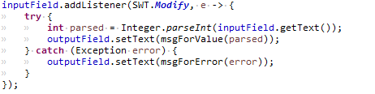
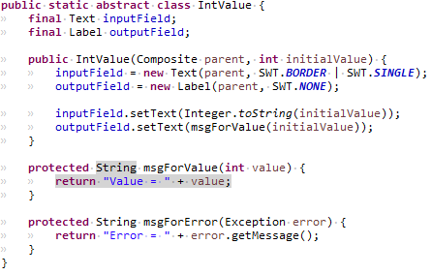
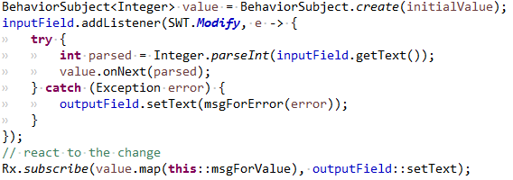
Events – nested calls
Observable – decouples the event’s source
from its effects

Slide 7
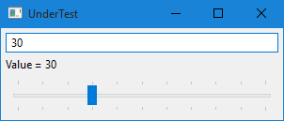
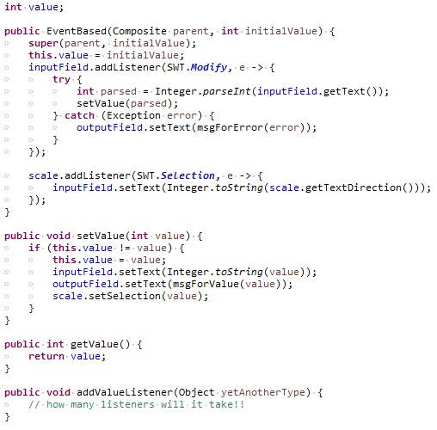
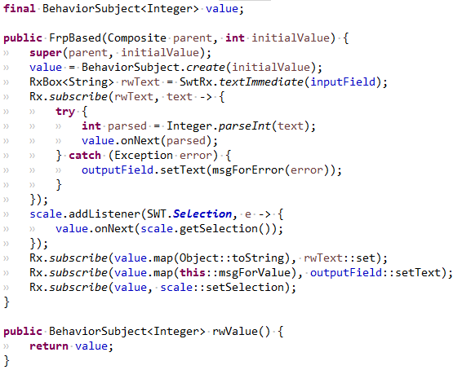
Just a smidge harder…
Events – nested calls
Observable – decouples the event’s source
from its effects

Slide 8
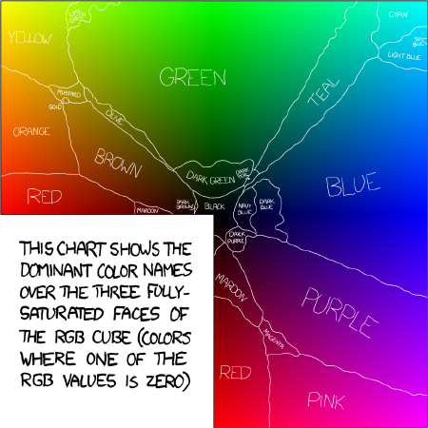
Xkcd Color Survey
Show the user a random RGB value
Ask them to name it
Take all the RGB values that were labeled with the same name and average them to find the “truest” red, green, vomit green, etc.

Slide 9
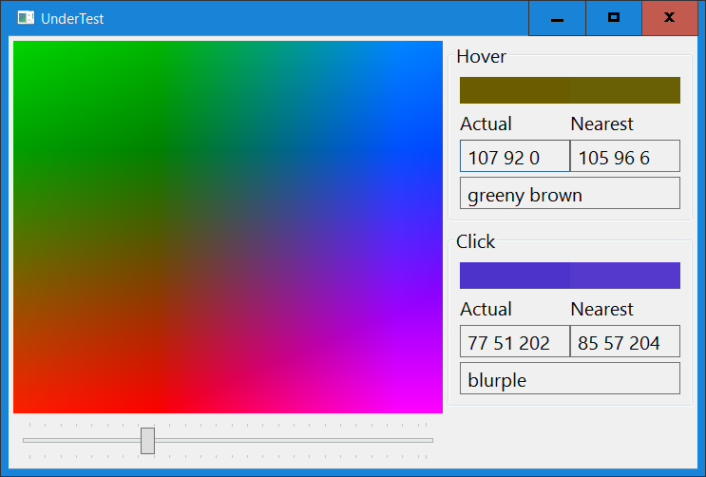
Given an RGB value, what is the nearest named RGB value?
CompletionStage<Map.Entry<String, RGB>> getNearestColor(RGB rgb)
How do we make this work?

Slide 10
Expose SWT Listeners
/** Adds the given listener to the color canvas. */
void addListener(int eventType, Listener listener);
/** Converts a coordinate to an RGB value. */
RGB toColor(int x, int y);
Create yet another event pair
RxJava
public class ColorEvent {
RGB color;
}
public interface ColorListener {
void handle(ColorEvent event);
}
void addMouseMoveListener(ColorListener listener);
void addMouseDownListener(ColorListener listener);
Observable<RGB> rxMouseMove();
Observable<RGB> rxMouseDown();

Slide 11
Passing errors (that you thought of)
Either<Value, Throwable>

Slide 12
Handling errors (that you didn’t think of)
Async code makes it easy to swallow errors
It’s a big problem with Observables and Futures
Too easy to subscribe to values, and forget to subscribe to errors
Current behavior is “swallow by default”
Log by default is much better…

Slide 13
Some useful libraries
Durian – no deps
Box -> a value you can get() and set()
Either
DurianRx – requires Durian and Guava (but we’re removing Guava)
RxBox -> a value you can get(), set(), and subscribe to()
Rx.subscribe(Observable/CompletionStage/ListenableFuture)
DurianSwt – requires the above and SWT / JFace
SwtRx.addListener()
SwtExec.async().subscribe()
InteractiveTest.testCmp()

Slide 14
Handling errors (that you didn’t think of)
Durian
Box -> a value you can get() and set()
Either
DurianRx
RxBox -> a value you can get(), set(), and subscribe to()
Rx.subscribe(Observable/CompletionStage/ListenableFuture)
DurianSwt
SwtRx.addListener()
SwtExec.async().subscribe()
InteractiveTest.testCmp()

Slide 15
Mapping Futures to Observables
A future returns either a value or an exception
Value -> onValue(), onCompleted()
Exception -> onError()
It makes sense to use the same subscription and error-handling policies for all async code.
Rx.subscribe(Future or Observable, onValue -> doSomething());
Automatically logs all exceptions.
If you set a magic system property, it will record the stacktrace at the time of subscription, and decorate any exceptions with their source
durian.plugins.com.diffplug.common.rx.RxTracingPolicy=com.diffplug.common.rx.RxTracingPolicy$LogSubscriptionTrace

Slide 16
SWT Threads
SwtExec.async() -> Display.asyncExec()
SwtExec.blocking() -> Display.syncExec()
SwtExec.immediate()
SwtExec.guardOn(control).subscribe(Observable / Future)
public void execute(Runnable runnable) {
if (Thread.currentThread() == display.getThread()) {
runnable.run();
} else {
display.asyncExec(runnable);
}
}

Slide 17
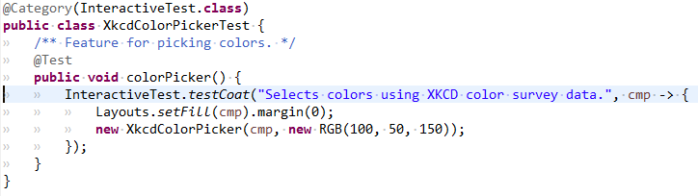
InteractiveTest
Ideally, all UI is tested with UI automation.
Practically, most UIs don’t have tests and are buggy.
Middle ground is a user-in-the-loop test suite, which can run on a headless server to make sure the tests still work for the user.
gradlew interactiveTest - runs interactive tests and prompts user
gradlew headlessTest - runs interactive tests for 500ms each

Slide 18



Code available at
diffplug.com/opensource
Get updates by following @diffplug
Evaluate the Sessions
Sign in and vote at eclipsecon.org
- 1
0
+ 1

